Slide 1
Key Club meeting
10/16/20

Slide 2
Agenda
Welcome!
What is Key Club?
Volunteering Opportunities
Next Meeting
Join Key Club!

Slide 3
What is Key Club?
What we’ve done:
Given over 150 hours of service opportunities
Worked with the FW Ronald McDonald House 12 times!
Been ranked 8/366 clubs in all of Texas-Oklahoma
Won 500$ from the FW Marathon
And more!
Key Club is an international high school community service organization with over 229,652 members worldwide!

Slide 4
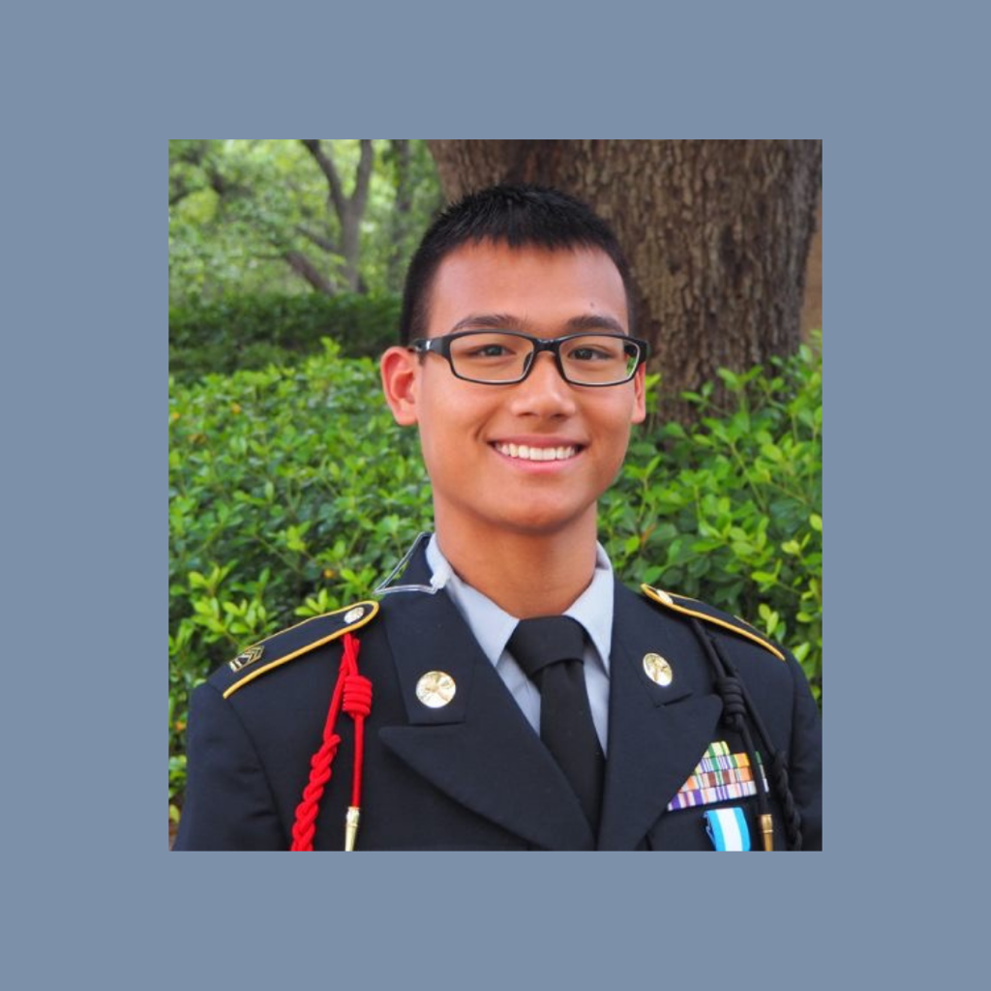
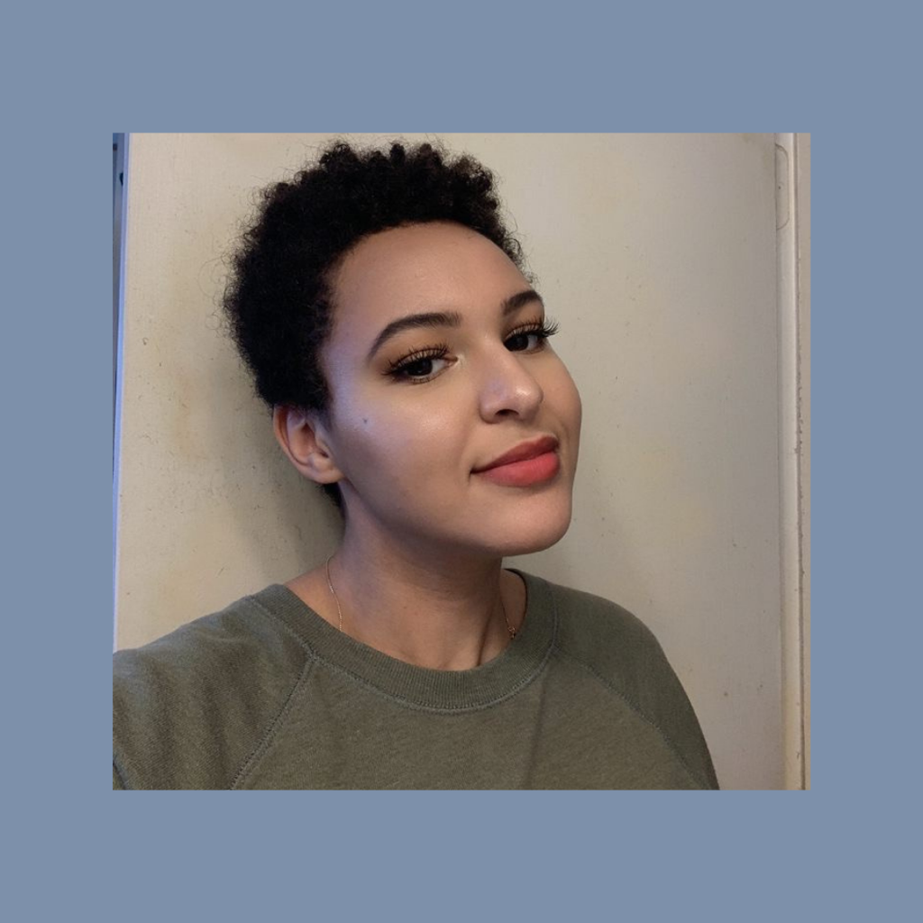
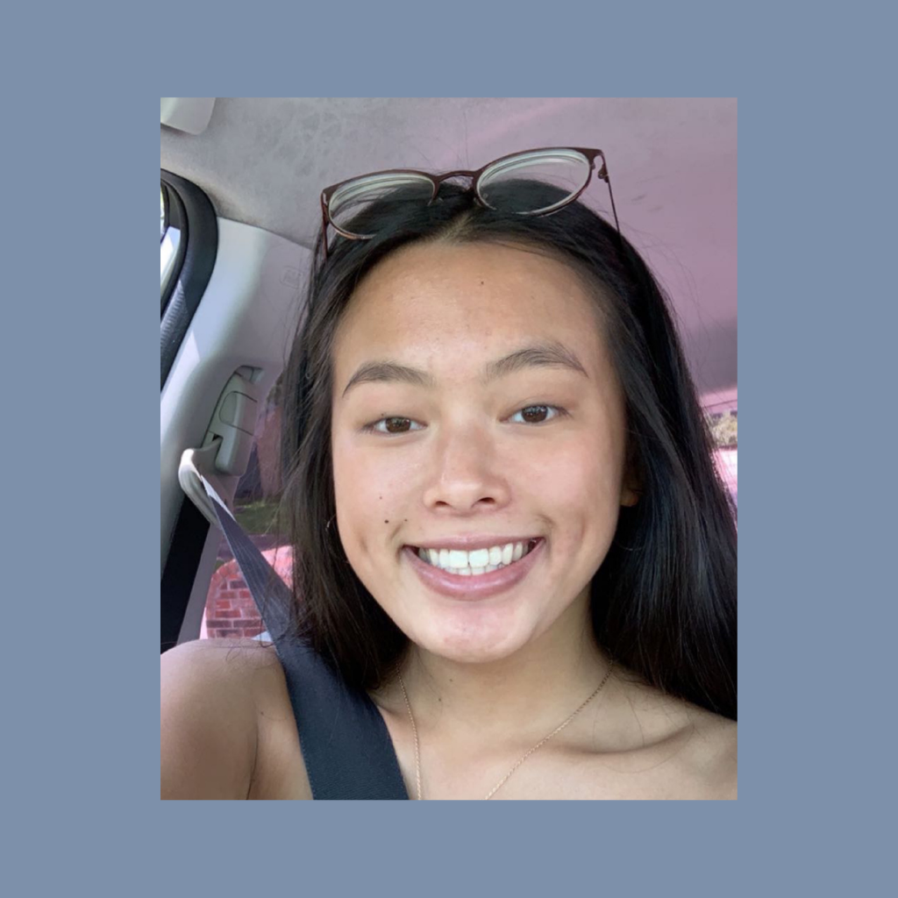
Meet the Officers
Victoria Deleray
Ben Mahanay
Avery Duke
Justice White
President
Vice president
Secretary
Treasurer
Andy Patenaude
Seth VanHorn
Lily Burdett
Lylia Tang
Webmaster
12th Grade Representative
11th Grade Representative
Editor
Notes:
Consider talking about:
Gaelic and Welsh influence
Christian influence
Spread to North America

Slide 5
SERVICE
SERVICE

Slide 6
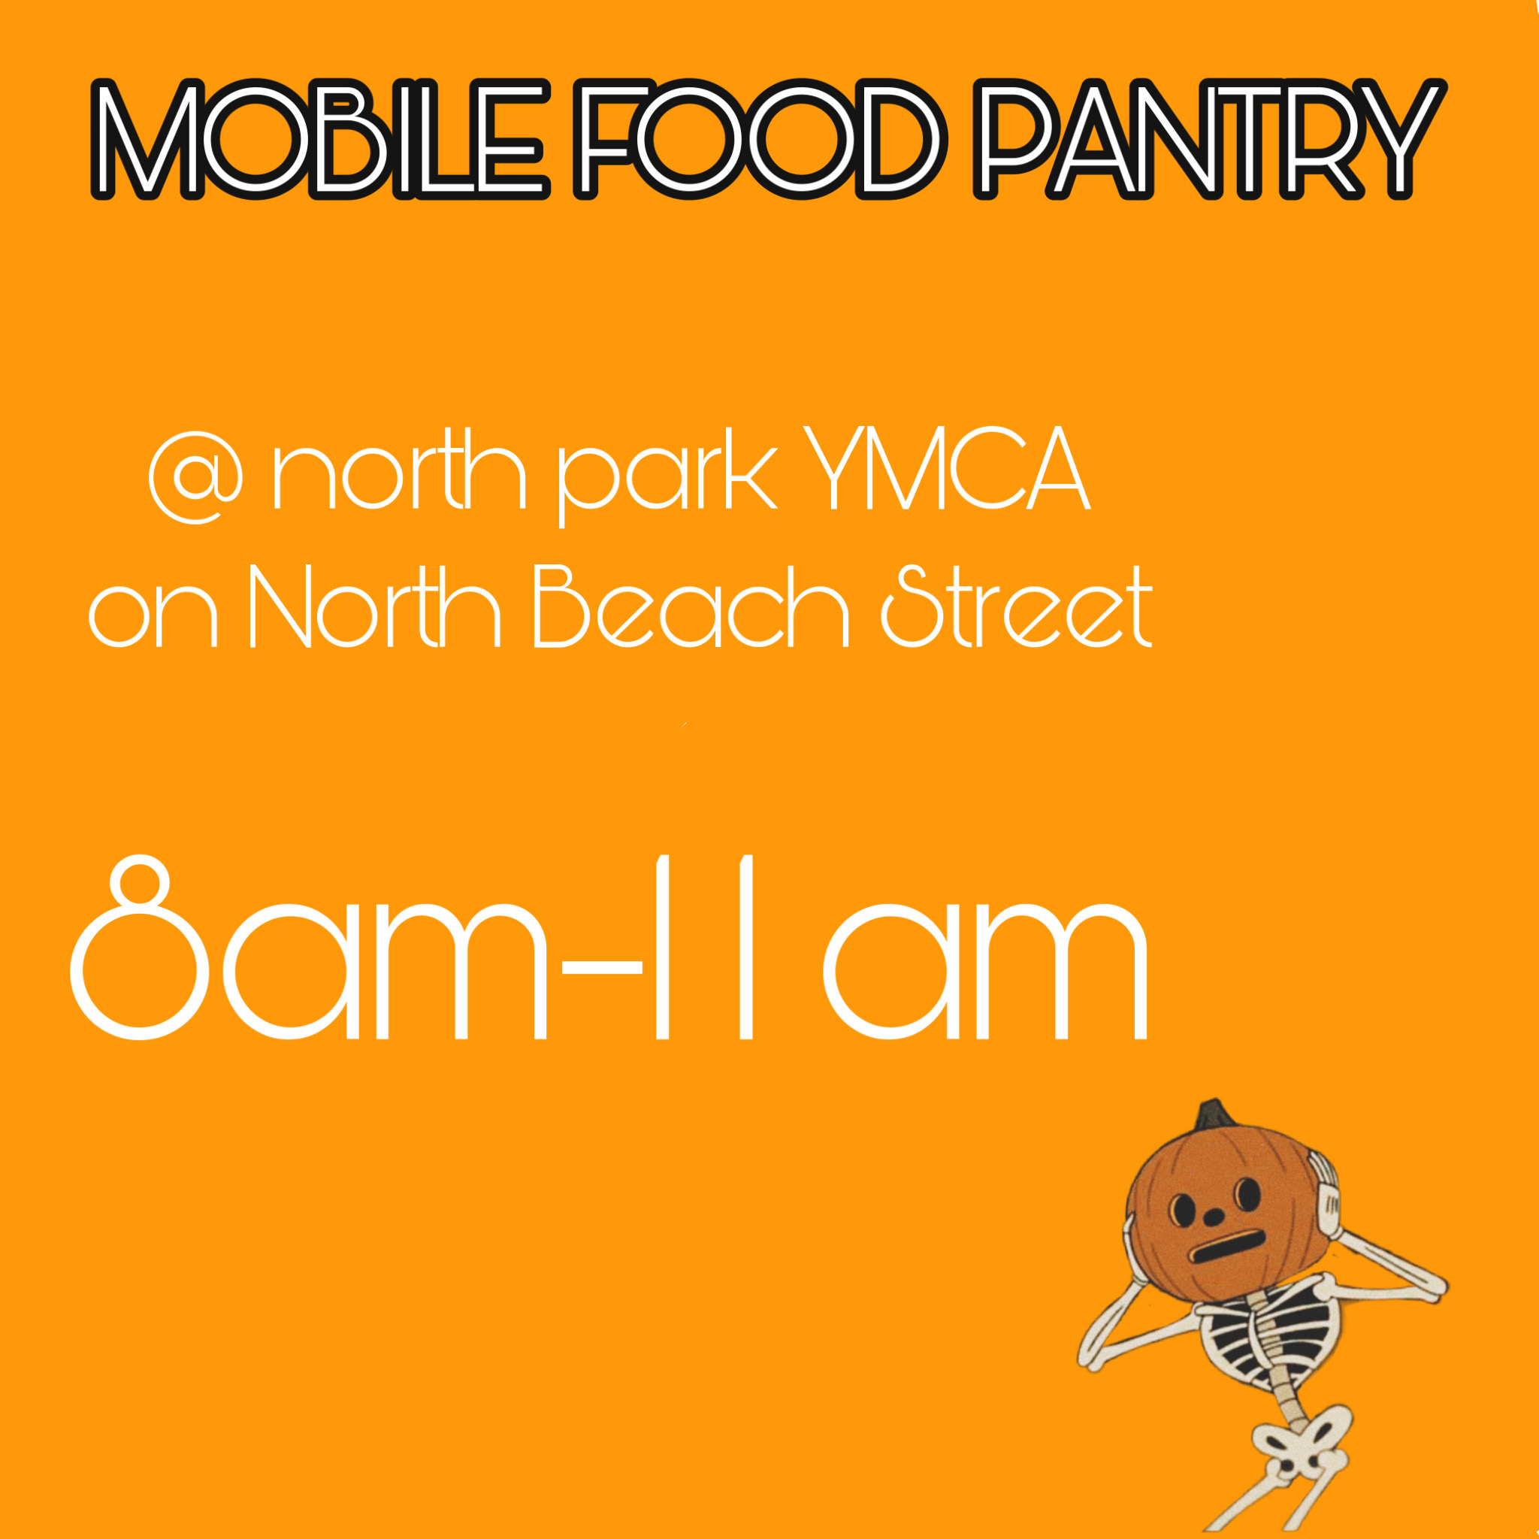
October 17th Opportunities
Contact 817-714-9962 and say you’re coming from key. club
Show up with water, a mask, gloves, and a trash bag!
Notes:
Consider talking about:
Judaism
Islam
Hinduism
Neopaganism

Slide 7
October 24th
https://www.signupgenius.com/go/60b0e48afa929a2fd0-tarrant1
3 spots left!!!

Slide 8
November 14th
Show up with a toy or book! Location and time tbd!

Slide 9
Thirst Project
https://my.thirstproject.org/team/319009
Use this link ^^^ to ”Join Team” where you can share the link on social media, or to friends and family.
The member with the most money raised that month wins a chick fil a gift card!

Slide 10
Next Meeting
October 30th
4-4:30
Meeting ID: 557 215 4907
Passcode: key

Slide 11
Put your full name, phone number, and grade in the chat if you would like to join our group me!

